Slide 1



ADULT
DATA
MARWAN

Slide 2



Table Of Content
01
Introduction to the Dataset
06
Outlier Detection
02
Overview of the Data
07
Correlation Analysis
03
Summary Statistics
08
Key Findings
04
Frequency Distributions
09
Vision & Mission
05
Data Skewness

Slide 3


Introduction to the Dataset :
This dataset appears to be the Adult dataset, also known as the "Census Income" dataset.

Slide 4



Overview of the Data :
DATA SOURCE
DATA SIZE
NTI
48842 rows × 15 columns

Slide 5
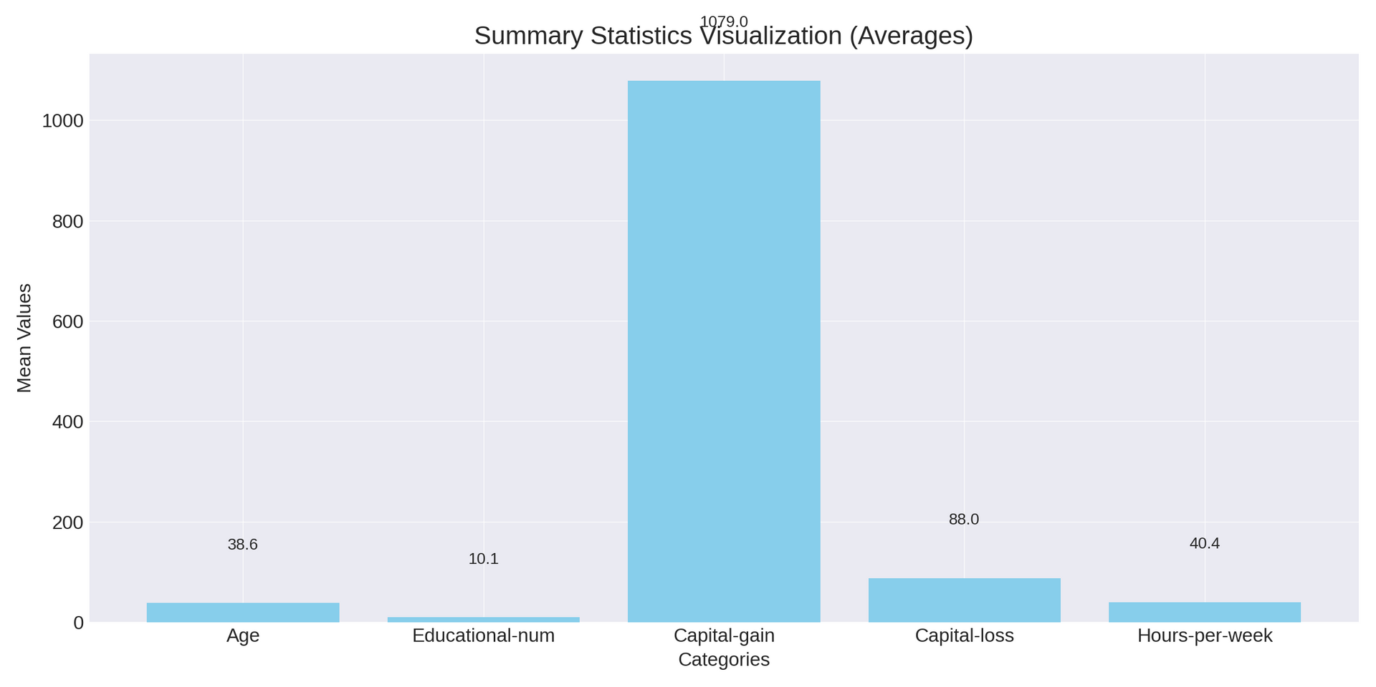
Summary Statistics :

Slide 6
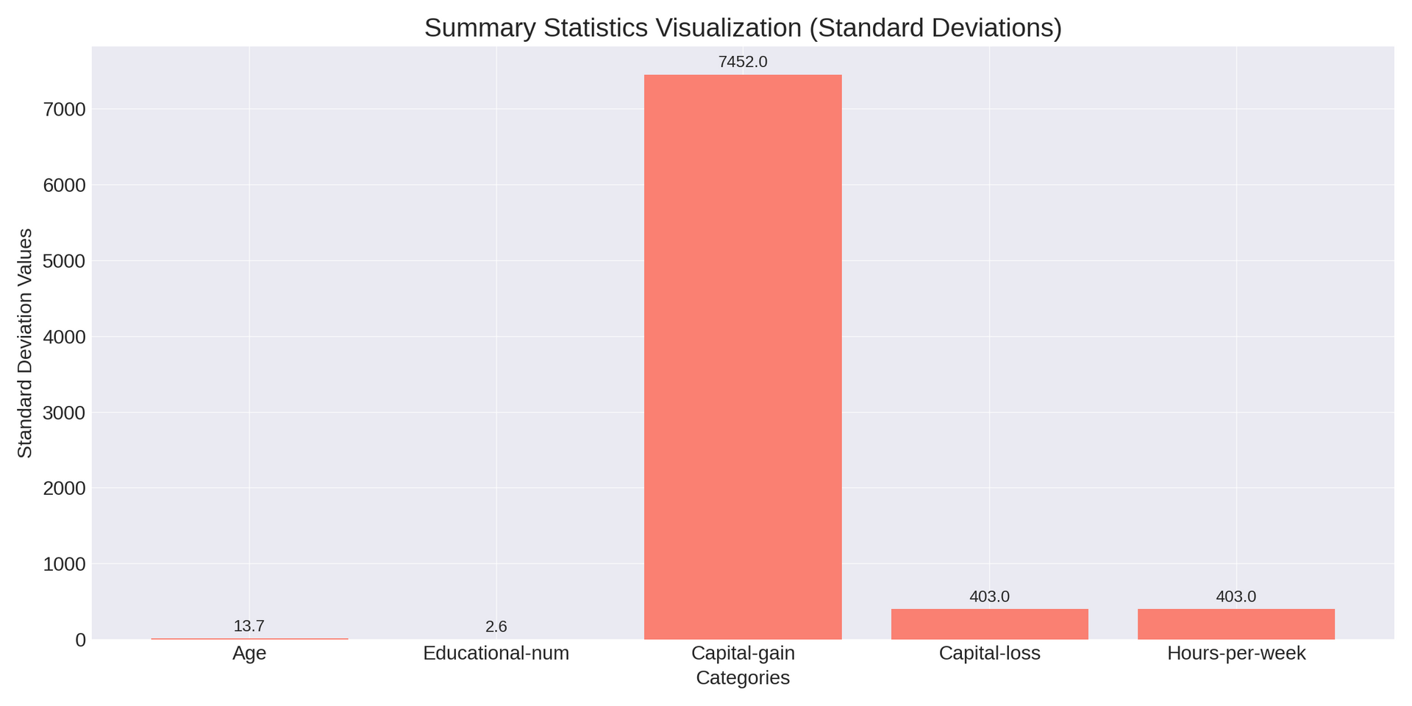
Summary Statistics :

Slide 7


Frequency Distributions :
workclass
education
marital-status
occupation
relationship
Private: 33,906
Self-emp-not-inc: 3,862
Local-gov: 3,136
HS-grad: 15,724
Some-college: 10,533
Bachelors: 8,270
Married-civ-spouse:
22,697
Never-married: 16,589
Prof-specialty: 6,144
Craft-repair: 6,059
Husband: 19,703
Not-in-family: 12,610
race
gender
native-country
income
White: 41,415
Black: 4,635
Male: 32,050
Female: 16,792
United-States: 44,467
Mexico: 951
<=50K: 37,155
> 50K: 11,687

Slide 8
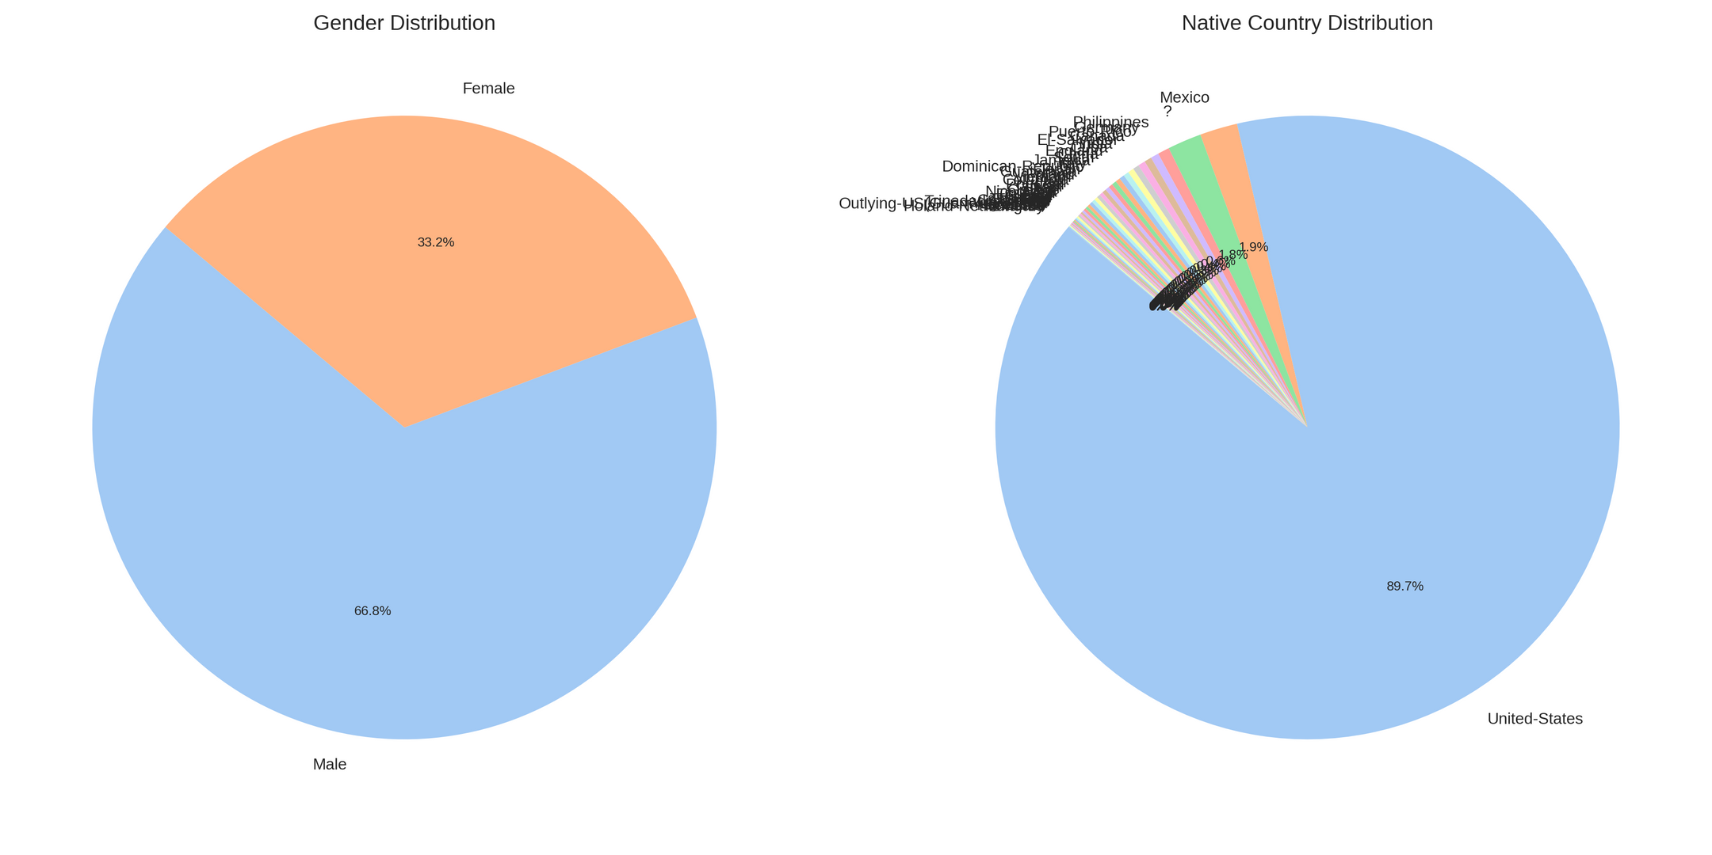
Frequency Distributions :

Slide 9
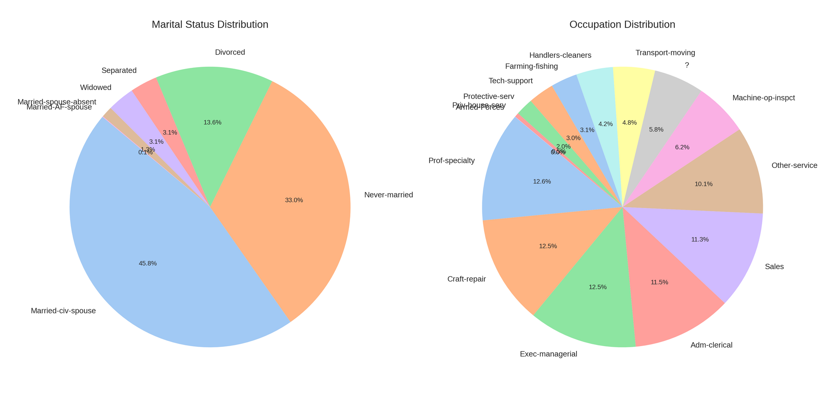
Frequency Distributions :

Slide 10
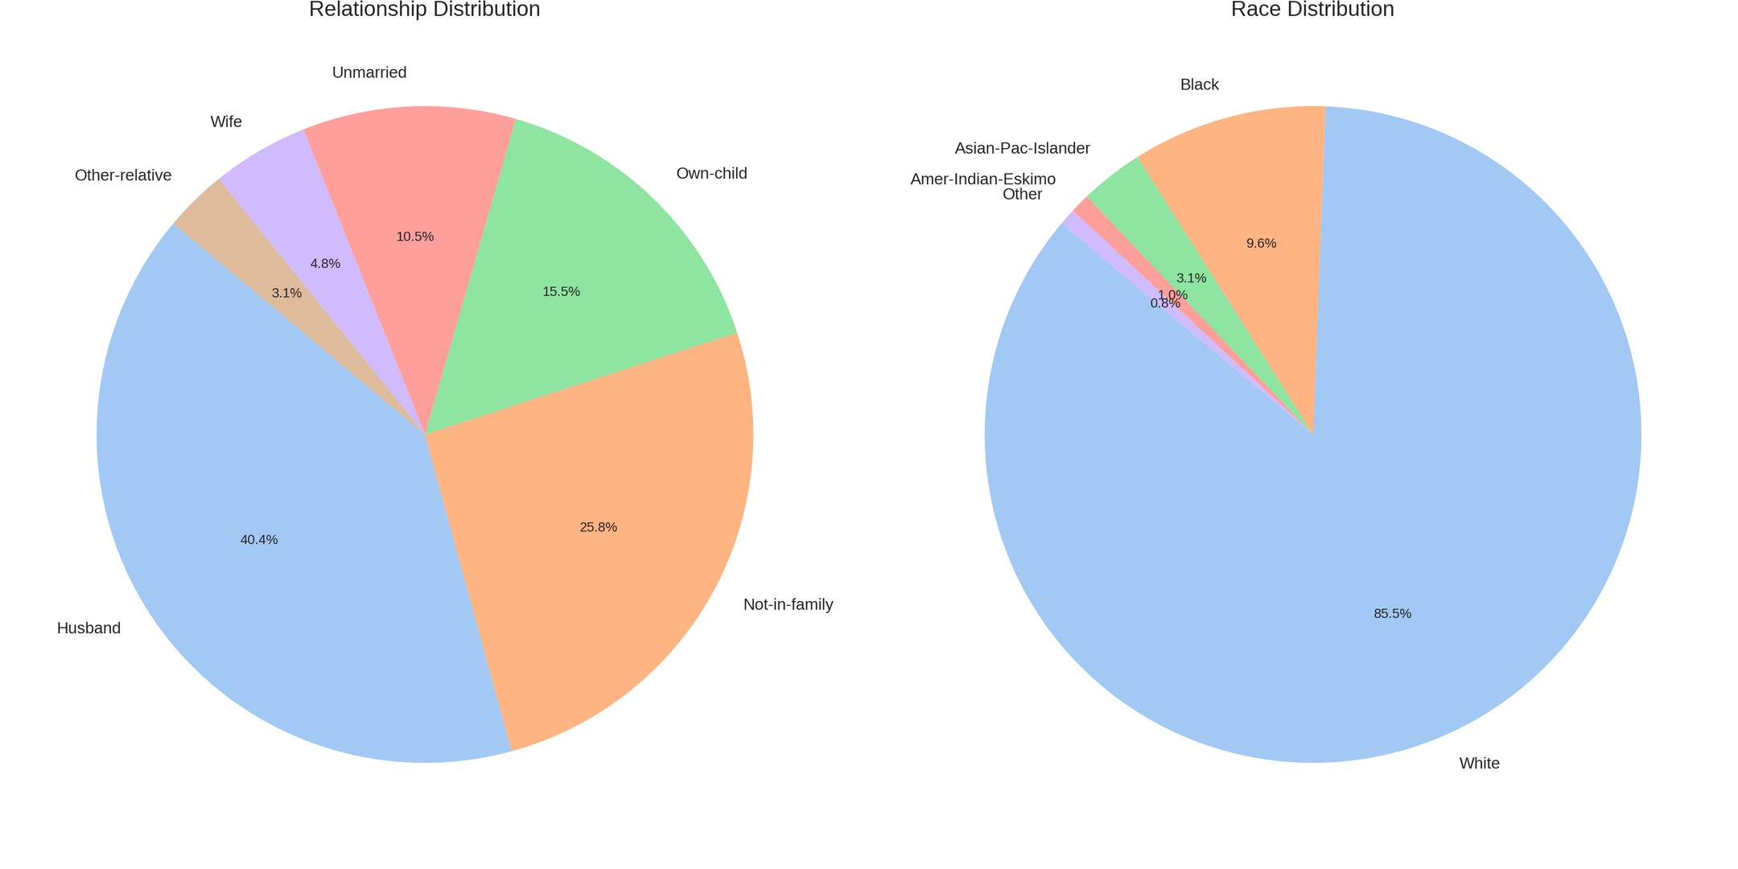
Frequency Distributions :

Slide 11
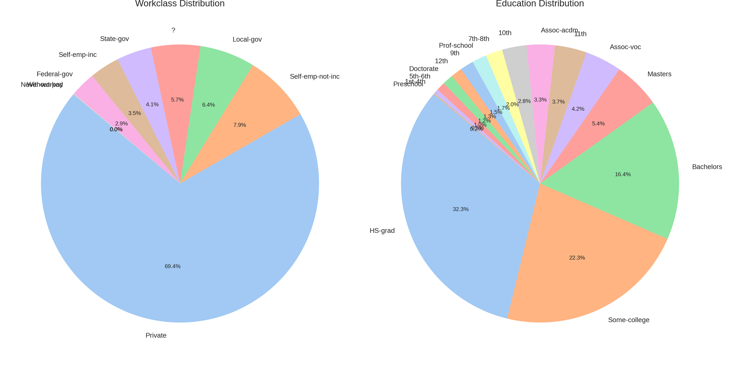
Frequency Distributions :

Slide 12
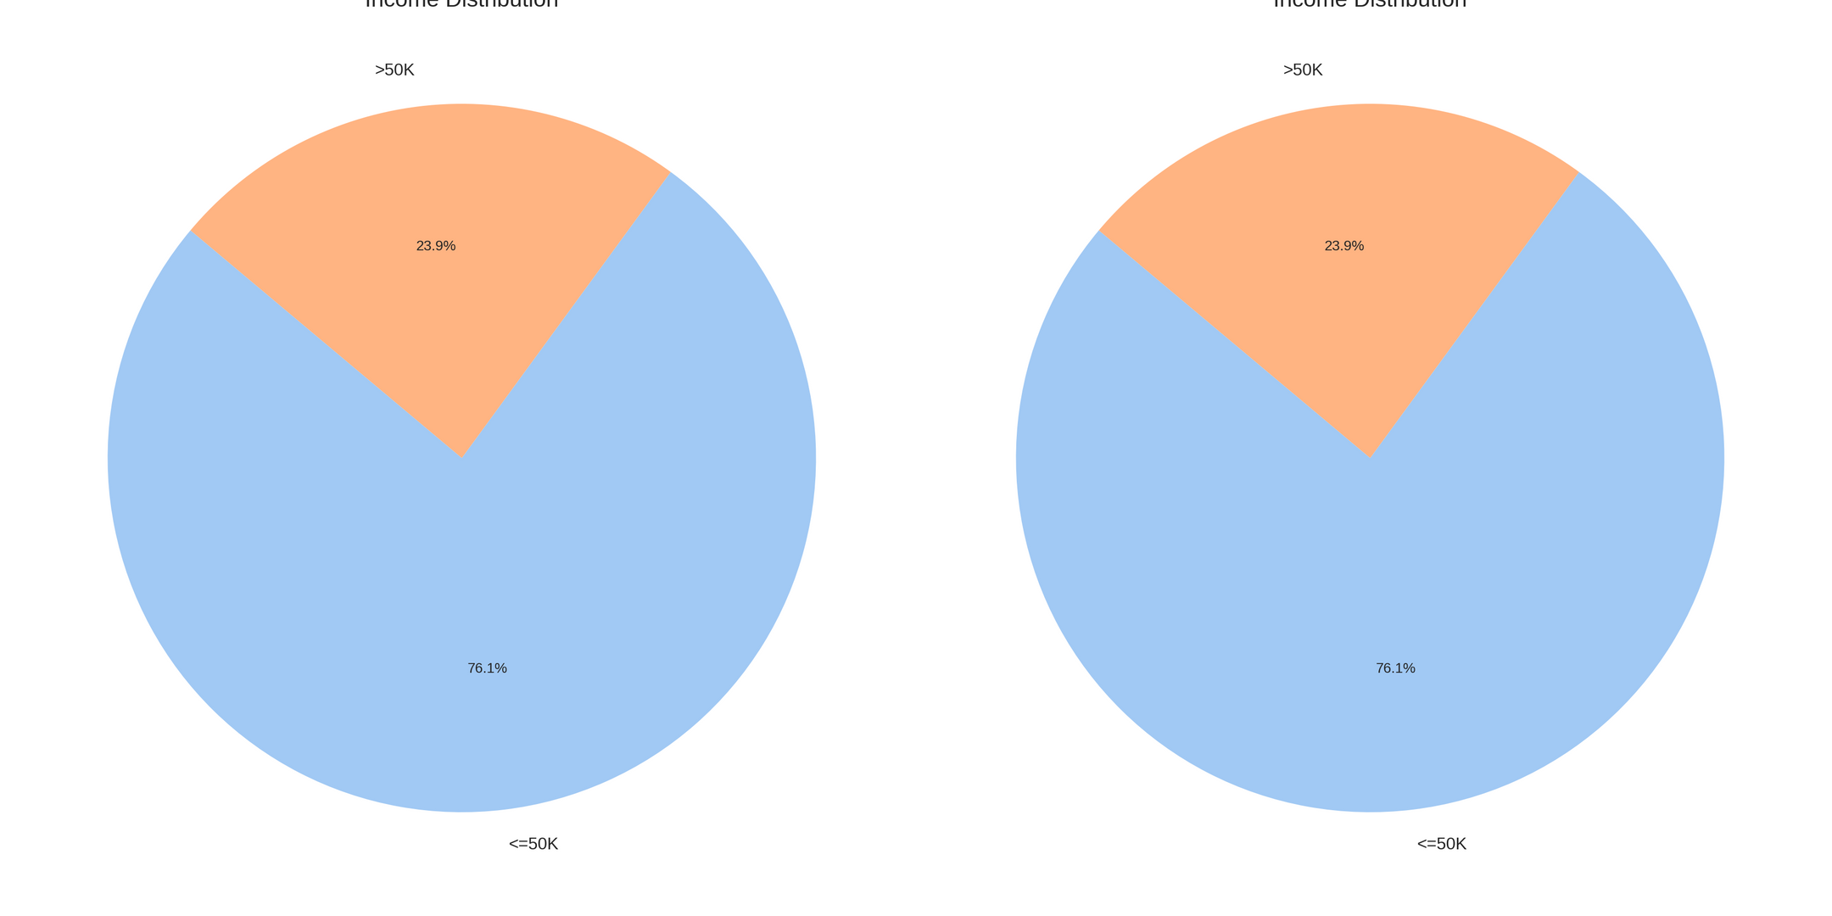
Frequency Distributions :

Slide 13
Data Skewness :
01
02
03
Age
Fnlwgt
Educational-num
Slightly right-skewed (0.56)
Right-skewed
(1.44)
Slightly left-skewed (-0.32)
04
05
06
Capital-gain
Capital-loss
Hours-per-week
Highly right-skewed (11.89)
Highly right-skewed (4.57)
Nearly symmetric
(0.24)

Slide 14
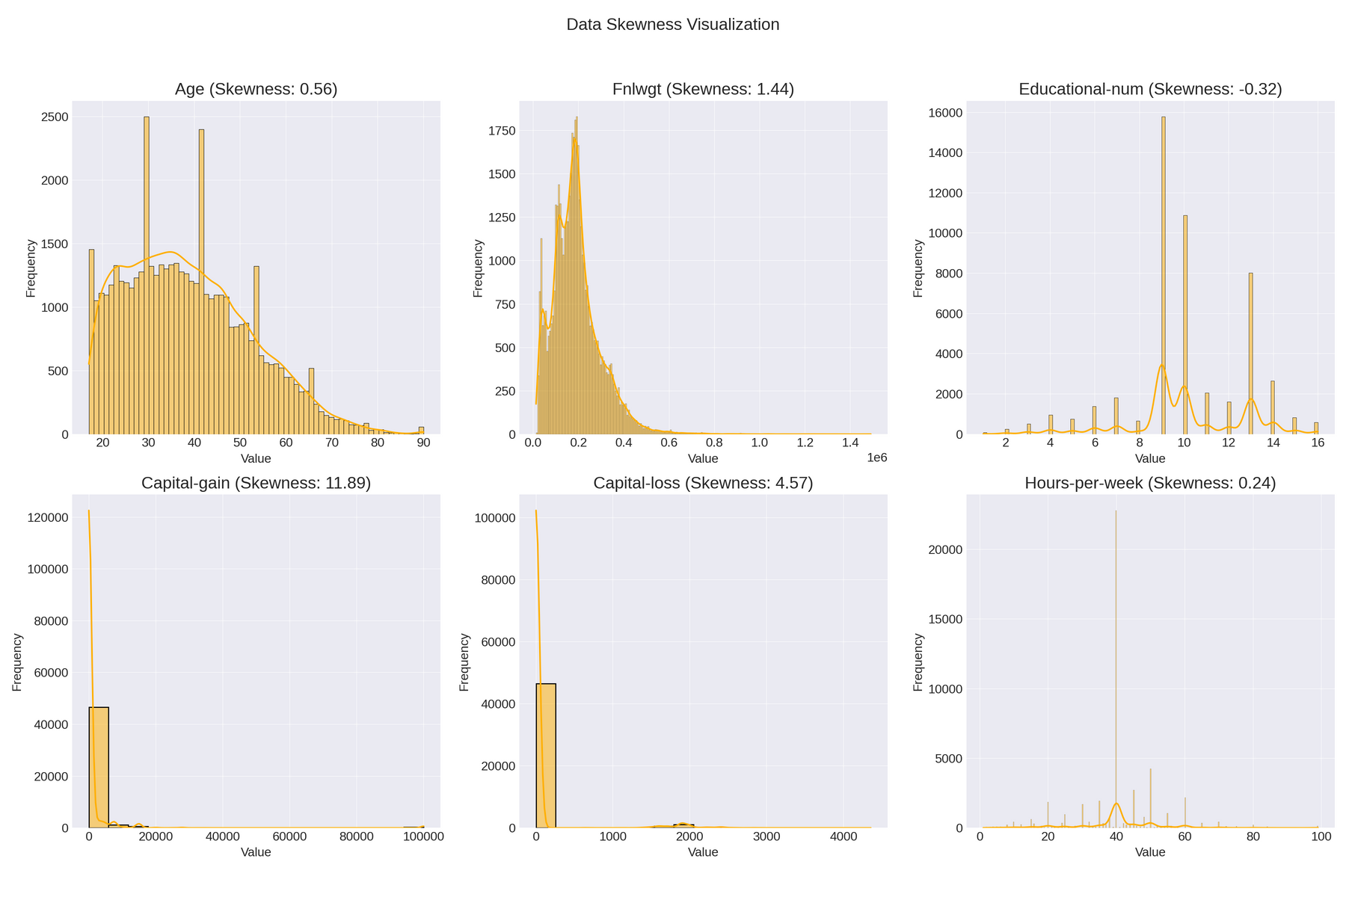
Data Skewness :

Slide 15
Outlier Detection :
01
02
03
Age
Fnlwgt
Educational-num
216
1453
1794
04
05
06
Capital-gain
Capital-loss
Hours-per-week
4035
2282
13,496

Slide 16
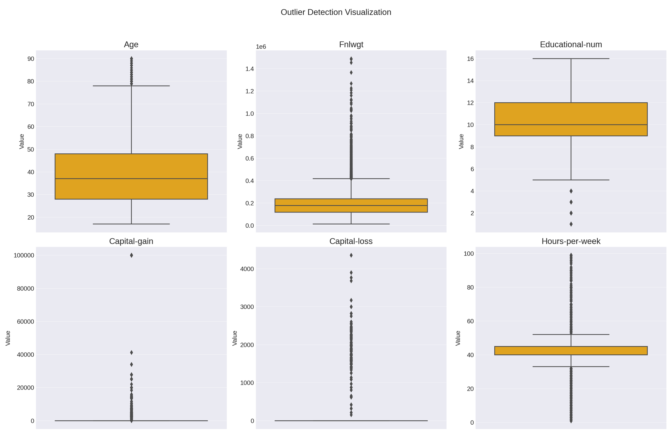
Outlier Detection :

Slide 17
Outlier Detection :

Slide 18
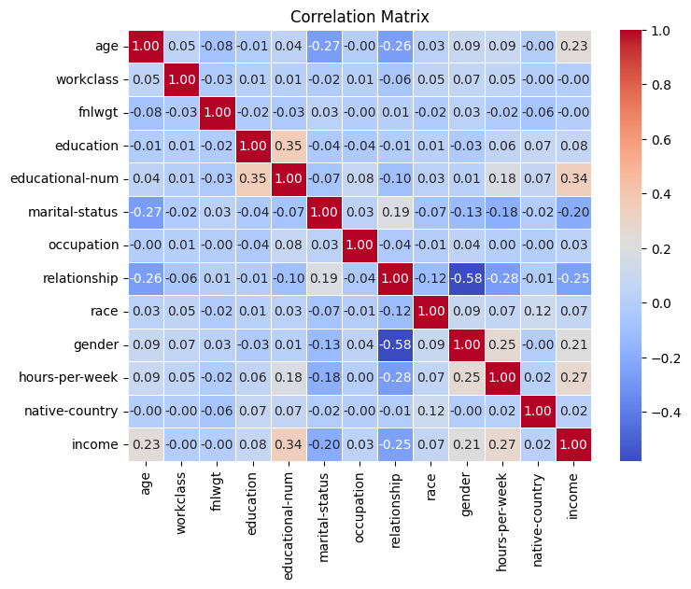
Correlation Analysis :
Correlation analysis is used to determine the relationships between numerical variables in the dataset. The goal is to understand if there is a relationship between the variables, whether it is positive (one variable increases as the other increases), negative (one variable decreases as the other increases), or none.

Slide 19
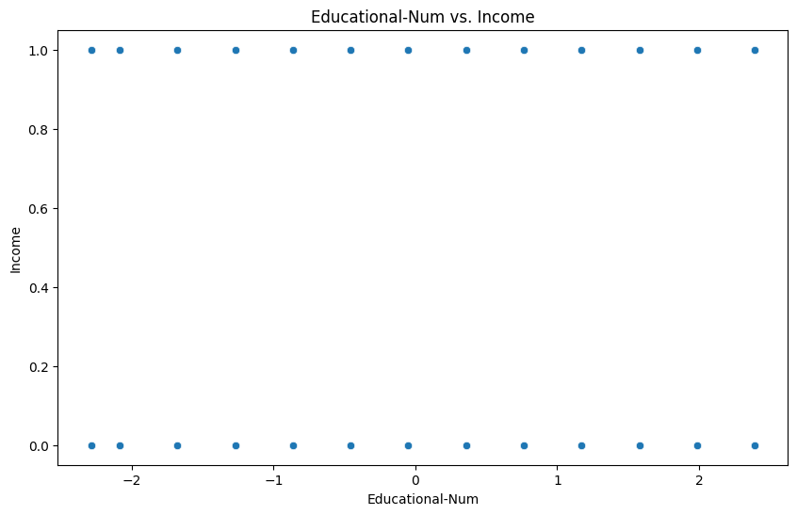
Highlight Significant Correlations:
Educational-num and Income:
Correlation Value: 0.34
Interpretation: There is a moderate positive correlation between educational attainment and income. Higher education levels are associated with higher incomes.

Slide 20
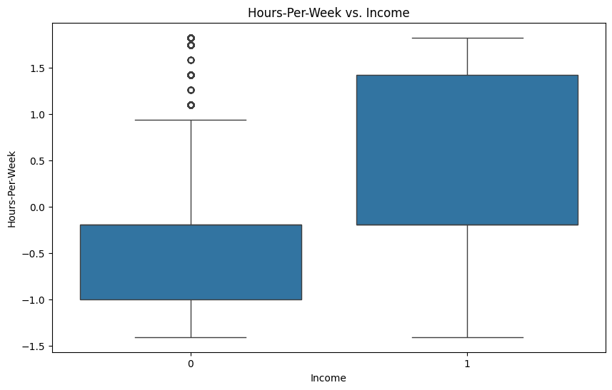
Highlight Significant Correlations:
Hours-per-week and Income:
Correlation Value: 0.27
Interpretation: There is a moderate positive correlation between hours worked per week and income. Individuals who work more hours per week tend to have higher incomes.

Slide 21
Key Findings :
Education and Income:
Higher education levels are associated with higher income.
Work Hours and Income:
More hours worked per week correlate with higher income.
Marital Status and Income:
Married individuals generally have lower incomes compared to unmarried individuals.
Demographics:
Majority of individuals are from the United States, with more males than females.
Predominantly White and Black races are represented.
Age:
Younger individuals are more likely to be unmarried.
Age distribution is slightly skewed to the right.
Financial Variability:
Capital gains and losses vary greatly with significant outliers.

Slide 22

Vision & Mission :
VISION
MISSION
"To pioneer data-driven innovations that harness the power of machine learning to solve complex challenges and drive meaningful advancements in predictive analytics."
The goal is typically to predict
whether an individual's income
exceeds $50,000 per year based on various attributes.

Slide 23
THANK
YOU
MARWAN

